Slide 1
CS2009 Design and Analysis of Algorithms
Understand Dynamic Programming

Slide 2
Dynamic Programming by Richard Bellman 1950s
The seven steps in the development of a dynamic programming algorithm are as follows:
Develop a recursive algorithm as per recursive property
Develop a memoized recursive algorithm
Convert the memoized recursive algorithm into iterative algorithm

Slide 3
Dynamic Programming: Steps
The seven steps in the development of a dynamic programming algorithm are as follows:
Establish a recursive property that gives the solution to an instance of the problem.
Develop a recursive algorithm as per recursive property
See if same instance of the problem is being solved again an again in recursive calls
Develop a memoized recursive algorithm
See the pattern in storing the data in the memory
Convert the memoized recursive algorithm into iterative algorithm
Optimize the iterative algorithm by using the storage as required (storage optimization)

Slide 4
Coin Row (CR) Problem
There is a row of n coins whose values are some positive integers c1, c2, . . . , cn, not necessarily distinct. The goal is to pick up the maximum amount of money subject to the constraint that no two coins adjacent in the initial row can be picked up.

Slide 5
CR Solution
Let F(n) be the maximum amount that can be picked up from the row of n coins. To derive a recurrence for F(n), we partition all the allowed coin selections into two groups:
those that include the last coin and those without it.
The largest amount we can get from the first group is equal to cn + F(n − 2)—the value of the n^{th} coin plus the maximum amount we can pick up from the first n − 2 coins.
The maximum amount we can get from the second group is equal to F(n − 1) by the definition of F(n).

Slide 6
CR Solution
Thus, we have the following recurrence subject to the obvious initial conditions:
F(n) = max{cn + F(n − 2), F(n − 1)} for n > 1,
F(0) = 0, F(1) = c1.

Slide 7
Coin-collecting (CC) problem
Several coins are placed in cells of an n × m board, no more than one coin per cell. A robot, located in the upper left cell of the board, needs to collect as many of the coins as possible and bring them to the bottom right cell. On each step, the robot can move either one cell to the right or one cell down from its current location. When the robot visits a cell with a coin, it always picks up that coin. Design an algorithm to find the maximum number of coins the robot can collect

Slide 8
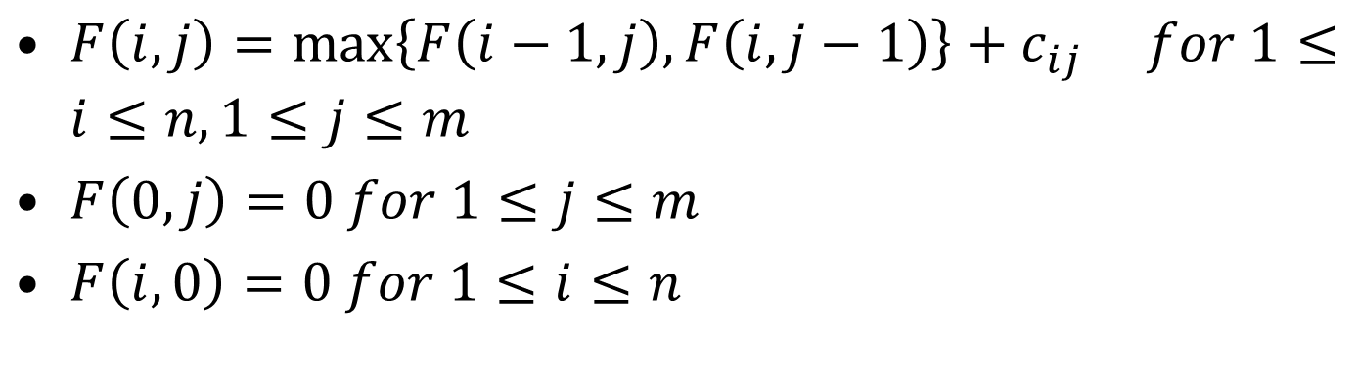
CC Solution
$F\left(i,j\right)=\max\left\{F\left(i−1,j\right),F\left(i,j−1\right)\right\}+c_{ij} for 1≤i≤n, 1≤j≤m$
$F\left(0,j\right)=0 for 1≤j≤m$
$F\left(i,0\right)=0 for 1≤i≤n$

Slide 9
Example
Write the recursive relation to generate the Fibonacci series of n numbers.

Slide 10
Dynamic Programming: Steps
The seven steps in the development of a dynamic programming algorithm are as follows:
Establish a recursive property that gives the solution to an instance of the problem.
Develop a recursive algorithm as per recursive property
See if same instance of the problem is being solved again an again in recursive calls
Develop a memoized recursive algorithm
See the pattern in storing the data in the memory
Convert the memoized recursive algorithm into iterative algorithm
Optimize the iterative algorithm by using the storage as required (storage optimization)

Slide 11
Recursive Definition to Algorithm
The Fibonacci numbers
0, 1, 1, 2, 3, 5, 8, 13, 21, 34, . . . ,
F(n) = F(n − 1) + F(n − 2) for n > 1
Fib(N)
{ if (N =< 1)
return 1;
else
return Fib(N-1) + Fib(N-2)
}

Slide 12

Exercise
Develop a recursive algorithm for the following definition, where P[] is a one-dimensional array having indices from i-1 to j, and m is a two-dimensional array of size ixj
$$m\left[i,j\right]=\{\begin{matrix}0 & if & i==j \\ \min_{i≤k<j}{m\left[i,k\right]+m\left[k+1,j\right]+p\left[i\right]∗p\left[k+1\right]∗p[j+1]} & if & i<j\end{matrix}$$

Slide 13
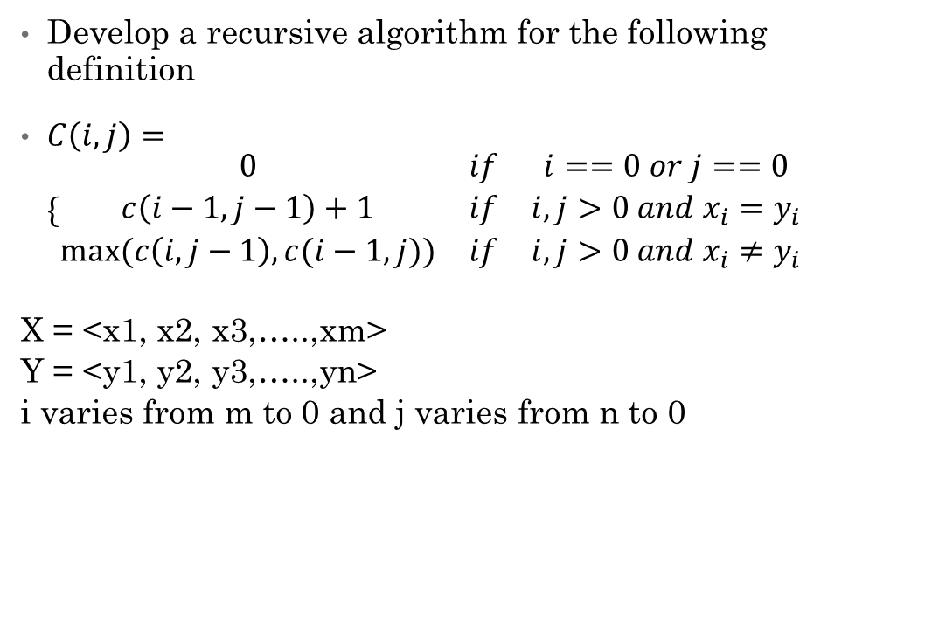
Exercise
Develop a recursive algorithm for the following definition
$C\left(i,j\right)=\{\begin{matrix}0 & if & i==0 or j==0 \\ c\left(i−1,j−1\right)+1 & if & i,j>0 and x_{i}=y_{i} \\ max⁡(c\left(i,j−1\right),c(i−1,j)) & if & i,j>0 and x_{i}≠y_{i}\end{matrix}$
X = <x1, x2, x3,…..,xm>
Y = <y1, y2, y3,…..,yn>
i varies from m to 0 and j varies from n to 0

Slide 14
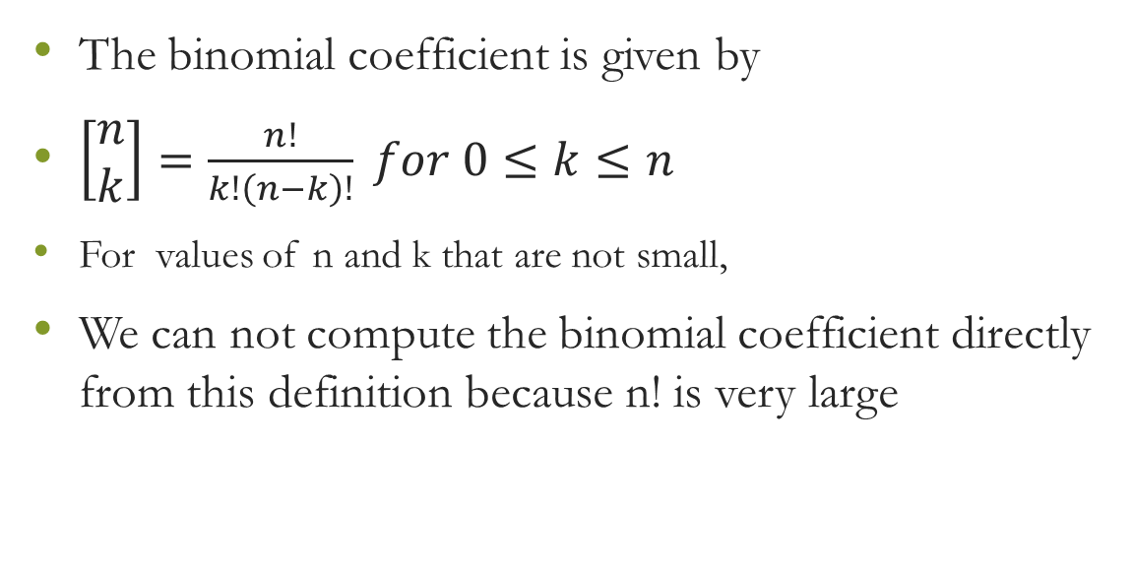
Dynamic Programming: Combinations Calculations
The binomial coefficient is given by
$\left[\begin{matrix}n \\ k\end{matrix}\right]=\frac{n!}{k!\left(n−k\right)!} for 0≤k≤n$
For values of n and k that are not small,
We can not compute the binomial coefficient directly from this definition because n! is very large

Slide 15

Dynamic Programming: Combinations Calculations
The binomial coefficient is given by
$$T\left[\begin{matrix}n \\ k\end{matrix}\right]=\{\begin{matrix}\left[\begin{matrix}n−1 \\ k−1\end{matrix}\right]+[\begin{matrix}n−1 \\ k\end{matrix}] & if & 0<k<n \\ 1 & if & k==0 or k==n\end{matrix}$$
Bin(n,k){
if(k==0||k==n){return 1}
else return Bin(n-1,k-1)+ Bin(n-1,k)
}

Slide 16
Dynamic Programming: Combinations Calculations
Int bin(int n, int k)
{
if (k = 0 or n = k )
return 1;
else
return(bin(n-1, k-1) + bin(n-1, k))
}

Slide 17
Dynamic Programming: Steps
The seven steps in the development of a dynamic programming algorithm are as follows:
Establish a recursive property that gives the solution to an instance of the problem.
Develop a recursive algorithm as per recursive property
See if same instance of the problem is being solved again an again in recursive calls
Develop a memoized recursive algorithm
See the pattern in storing the data in the memory
Convert the memoized recursive algorithm into iterative algorithm
Optimize the iterative algorithm by using the storage as required (storage optimization)

Slide 18
Dynamic Programming: Combinations Calculations
bin(n,k)=bin(n-1,k-1),bin(n-1,k)
bin(n,k)=bin(n-2,k-2),bin(n-2,k-1),bin(n-2,k-1),bin(n-2,k)
B(n,k)
B(n-1,k-1)
B(n-1,k)
B(n-2,k-2)
B(n-2,k-1)
B(n-2,k-1)
B(n-2,k)
B(n-3,k-2)
B(n-3,k-2)

Slide 19
Dynamic Programming: Steps
The seven steps in the development of a dynamic programming algorithm are as follows:
Establish a recursive property that gives the solution to an instance of the problem.
Develop a recursive algorithm as per recursive property
See if same instance of the problem is being solved again an again in recursive calls
Develop a memoized recursive algorithm
See the pattern in storing the data in the memory
Convert the memoized recursive algorithm into iterative algorithm
Optimize the iterative algorithm by using the storage as required (storage optimization)

Slide 20
Develop a memoized recursive algorithm
Int bin(int n, int k)
{
if (k = 0 or n = k )
return 1;
else
return(bin(n-1, k-1) + bin(n-1, k))
}
Take an array of size?
Then store results in the
array, no need to
compute it again and
Again
Then see the pattern for
data storage in the array

Slide 21
Dynamic Programming: Combinations Calculations
An efficient algorithm will be developed using dynamic programming approach.
We will use the recursive definition to construct our solution in an array B.
Where B[i, j] will contain

Slide 22
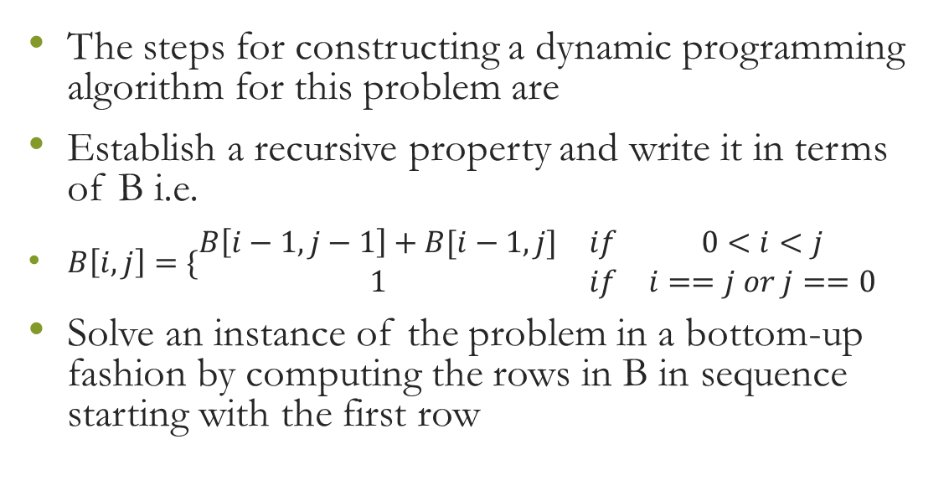
Dynamic Programming: Combinations Calculations
The steps for constructing a dynamic programming algorithm for this problem are
Establish a recursive property and write it in terms of B i.e.
$B\left[i,j\right]=\{\begin{matrix}B\left[i−1,j−1\right]+B[i−1,j] & if & 0<i<j \\ 1 & if & i==j or j==0\end{matrix}$
Solve an instance of the problem in a bottom-up fashion by computing the rows in B in sequence starting with the first row

Slide 23
Dynamic Programming: Steps
The seven steps in the development of a dynamic programming algorithm are as follows:
Establish a recursive property that gives the solution to an instance of the problem.
Develop a recursive algorithm as per recursive property
See if same instance of the problem is being solved again an again in recursive calls
Develop a memoized recursive algorithm
See the pattern in storing the data in the memory
Convert the memoized recursive algorithm into iterative algorithm
Optimize the iterative algorithm by using the storage as required (storage optimization)

Slide 24

Dynamic Programming: Combinations Calculations
0 1 2 3 4
0 1
1 1 1
2 1 2 1
3 1 3 3 1
4 1 4 6 4 1
$B[i, j] =B[i−1, j−1] B[i−1, j]$
Each successive row is computed from the row preceding it using the recursive property.

Slide 25
Dynamic Programming Combinations Calculations Example
Compute B[4, 2] =
Compute row 0: B[0, 0] = 1
Compute row 1: B[1, 0] = 1
B[1, 1] = 1
Compute row 2:
B[2, 0] = 1
B[2, 1] = B[1, 0] + B[1, 1] = 1 + 1 = 2
B[2, 2] = 1
Compute row 3: B[3, 0] = 1
B[3, 1] = B[2, 0] + B[2, 1] = 1 + 2 = 3
B[3, 2] = B[2, 1] + B[2, 2] = 2 + 1 = 3
Compute row 4: B[4, 0] = 1
B[4, 1] = B[3, 0] + B[3, 1] = 1 + 3 = 4
B[4, 2] = B[3, 1] + B[3, 2] = 3 + 3 = 6

Slide 26
Dynamic Programming: Steps
The seven steps in the development of a dynamic programming algorithm are as follows:
Establish a recursive property that gives the solution to an instance of the problem.
Develop a recursive algorithm as per recursive property
See if same instance of the problem is being solved again an again in recursive calls
Develop a memoized recursive algorithm
See the pattern in storing the data in the memory
Convert the memoized recursive algorithm into iterative algorithm
Optimize the iterative algorithm by using the storage as required (storage optimization)

Slide 27
Dynamic Programming Combinations Calculations Algorithm
Int bin(int n, int k)
{
int i, j;
int B[0..n, 0..k];
for i = 0 to n
for j = 0 to minimum(i, k)
if( j = 0 or j = i)
B[i, j] = 1;
else
B[i, j] = B[i-1, j-1] + B[i-1, j];
return B[n, k]
}

Slide 28
Dynamic Programming: Steps
The seven steps in the development of a dynamic programming algorithm are as follows:
Establish a recursive property that gives the solution to an instance of the problem.
Develop a recursive algorithm as per recursive property
See if same instance of the problem is being solved again an again in recursive calls
Develop a memoized recursive algorithm
See the pattern in storing the data in the memory
Convert the memoized recursive algorithm into iterative algorithm
Optimize the iterative algorithm by using the storage as required (storage optimization)

Slide 29
Exercise
Initialise a two dimensional array A[1..n, 1..n] using following definition with an efficient algorithm.
A[i, j] = i + j if i = j
A[i, j] = Min(A[i, j-1], A[i+1, j])+ (i+j) if i < j
A[i, j] = Max(A[i-1, j], A[i, j+1])+ (i *j) if i > j
Where i is for row index and j is for column index.

Slide 30
CS2009 Design and Analysis of Algorithms
Matrix Chain Product

Slide 31
Matrix Chain Multiplication
Given some matrices to multiply, determine the best order to multiply them so you minimize the number of single element multiplications.
i.e. Determine the way the matrices are parenthesized.
First off, it should be noted that matrix multiplication is associative, but not commutative. But since it is associative, we always have:
((AB)(CD)) = (A(B(CD))), or any other grouping as long as the matrices are in the same consecutive order.
BUT NOT: ((AB)(CD)) = ((BA)(DC))

Slide 32
Matrix Chain Multiplication
It may appear that the amount of work done won’t change if you change the parenthesization of the expression, but we can prove that is not the case!
Let us use the following example:
Let A be a 2x10 matrix
Let B be a 10x50 matrix
Let C be a 50x20 matrix
But FIRST, let’s review some matrix multiplication rules…

Slide 33
Matrix Chain Multiplication
Let’s get back to our example: We will show that the way we group matrices when multiplying A, B, C matters:
Let A be a 2x10 matrix
Let B be a 10x50 matrix
Let C be a 50x20 matrix
Consider computing A(BC):
# multiplications for (BC) = 10x50x20 = 10000, creating a 10x20 answer matrix
# multiplications for A(BC) = 2x10x20 = 400
Total multiplications = 10000 + 400 = 10400
Consider computing (AB)C:
# multiplications for (AB) = 2x10x50 = 1000, creating a 2x50 answer matrix
# multiplications for (AB)C = 2x50x20 = 2000,
Total multiplications = 1000 + 2000 = 3000
Notes:
Consider computing A(BC)
We multiply BC first, how many element multiplications are required?
What are the dimensions of our resulting matrix?
Then we multiply A(BC)
How many element multiplications are required?
What are the TOTAL element multiplications??
Consider computing (AB)C
We multiply AB first, how many element multiplications are required?
What are the dimensions of our resulting matrix?
Then we multiply (AB)C
How many element multiplications are required?
What are the TOTAL element multiplications??
IS THERE A DIFFERENCE BETWEEN THE NUMBER OF MULTIPLICATIONS necessary for the different groupings??

Slide 34
Matrix Chain Multiplication
Thus, our goal today is:
Given a chain of matrices to multiply, determine the fewest number of multiplications necessary to compute the product.

Slide 35
Matrix Chain Multiplication
Formal Definition of the problem:
Let A = A₀• A₁• ... A_{n-1}
Let N_{i,j} denote the minimal number of multiplications necessary to find the product:
A_{i}• A_{i+1}• ... A_{j}.
And let d_{i}xd_{i+1} denote the dimensions of matrix A_{i}.
We must attempt to determine the minimal number of multiplications necessary(N_{0,n-1}) to find A,
assuming that we simply do each single matrix multiplication in the standard method.

Slide 36
Matrix Chain Multiplication
Our final multiplication will ALWAYS be of the form
(A₀• A₁• ... A_{k}) • (A_{k+1}• A_{k+2}• ... A_{n-1})
There is exactly one value of k for which we should "split" our work into two separate cases so that we get an optimal result.
Here is a list of the cases to choose from:
(A₀) • (A₁• A_{k+2}• ... A_{n-1})
(A₀• A₁) • (A₂• A_{k+2}• ... A_{n-1})
(A₀• A₁•A₂) • (A₃• A_{k+2}• ... A_{n-1})
...
(A₀• A₁• ... A_{n-3}) • (A_{n-2} • A_{n-1})
(A₀• A₁• ... A_{n-2}) • (A_{n-1})
Basically, count the number of multiplications in each of these choices and pick the minimum.
One other point to notice is that you have to account for the minimum number of multiplications in each of the two products.

Slide 37
Matrix Chain Multiplication
Consider the case multiplying these 4 matrices:
A: 2x4
B: 4x2
C: 2x3
D: 3x1
1. (A)(BCD) - This is a 2x4 multiplied by a 4x1,
so 2x4x1 = 8 multiplications, plus whatever work it will take to multiply (BCD).
2. (AB)(CD) - This is a 2x2 multiplied by a 2x1,
so 2x2x1 = 4 multiplications, plus whatever work it will take to multiply (AB) and (CD).
3. (ABC)(D) - This is a 2x3 multiplied by a 3x1,
so 2x3x1 = 6 multiplications, plus whatever work it will take to multiply (ABC).

Slide 38
Matrix Chain Multiplication
The optimal way of matrices multiplication from our observations is as.
Split matrix chain in to two chains by finding the splitting position as
Minimum number of multiplications needed to perform in both chains
Minimum number of multiplications needed to multiply final result of these two chains.

Slide 39
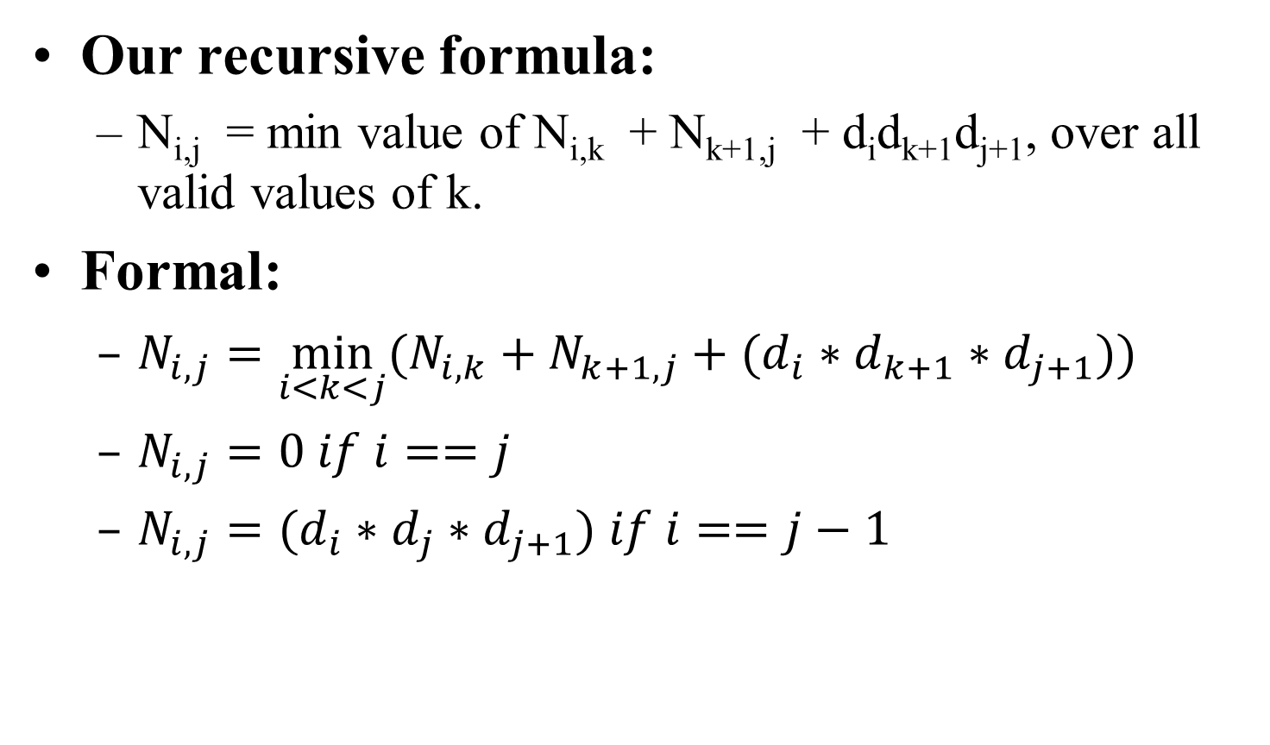
Matrix Chain Multiplication
Our recursive formula:
N_{i,j} = min value of N_{i,k} + N_{k+1,j} + d_{i}d_{k+1}d_{j+1}, over all valid values of k.
Formal:
$N_{i,j}=\min_{i<k<j}{(N_{i,k}+N_{k+1,j}+(d_{i}∗d_{k+1}∗d_{j+1}))}$
$N_{i,j}=0 if i==j$
$N_{i,j}=(d_{i}∗d_{j}∗d_{j+1}) if i==j−1$

Slide 40
Matrix Chain Multiplication
Recursive Algorithm:
N(i,j,d){
if(i==j) return 0;
else if (i=j-1) return d[i]*d[j]*d[j+1]
else {
min=infinity;
for(int k=i+1;k<j;k++){
if(min>N(i,k)+N(k+1,j)+(d[i]*d[k+1]*d[j+1]))
min=N(i,k)+N(k+1,j)+(d[i]*d[k+1]*d[j+1]);
}
return min;
}
}

Slide 41
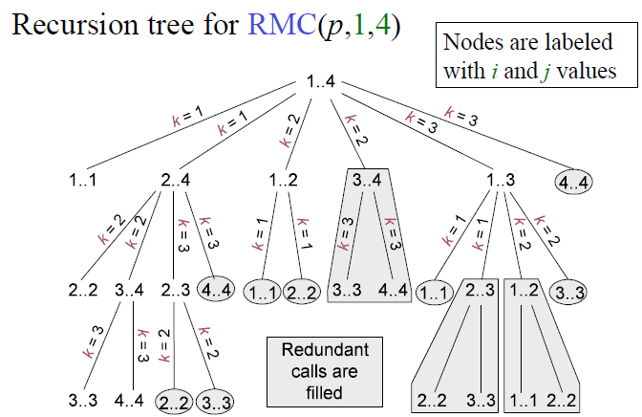
Recursive Matrix-chain Order

Slide 42
Elements of Dynamic Programming
When should we look for a DP solution to an optimization problem?
Two key ingredients for the problem
Optimal substructure
Overlapping subproblems

Slide 43
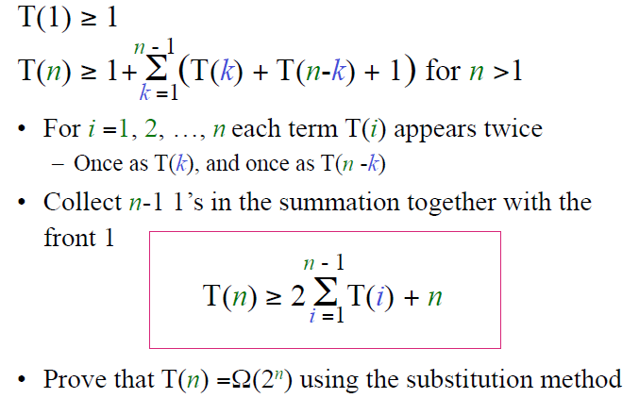
Running Time of Matrix Chain Ordering

Slide 44
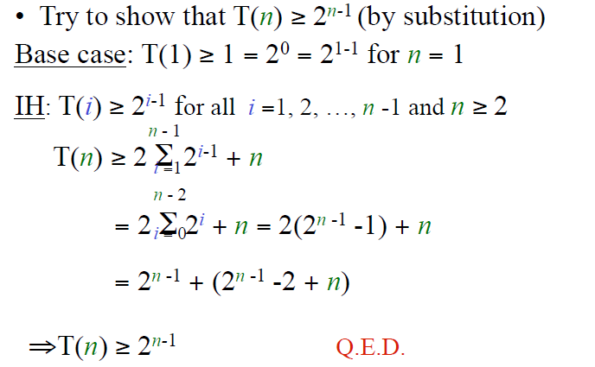

Slide 45

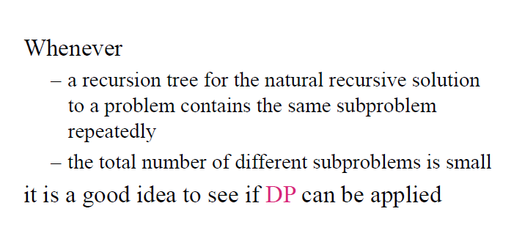

Slide 46
Memoized Recursive Algorithm
Offers the efficiency of the usual DP approach while maintaining top-down strategy
Maintains an entry in a table for the solution to each subproblem
Each table entry contains a special value to indicate that the entry has yet to be filled in
When the sub-problem is first encountered its solution is computed and then stored in the table
Each subsequent time that the sub-problem encountered the value stored in the table is simply looked up and returned
The approach assumes that
The set of all possible sub-problem parameters are known
The relation between the table positions and subproblems is established

Slide 47
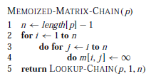
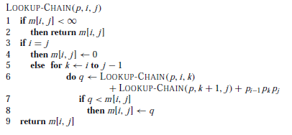
Memoized Recursive Algorithm

Slide 48
Matrix Chain Multiplication
Algorithm:
Initialize N[i][i] = 0, and all other entries in N to ∞.
for i=1 to n-1 do the following
for j=0 to n-1-i do
for k=j to j+i-1
if (N[j][j+i-1] > N[j][k]+N[k+1][j+i-1]+d_{j}d_{k+1}d_{i+j})
N[j][j+i-1]= N[j][k]+N[k+1][j+i-1]+d_{j}d_{k+1}d_{i+j}
Basically, we’re checking different places to “split” our matrices by checking different values of k and seeing if they improve our current minimum value.

Slide 49
CS2009 Design and Analysis of Algorithms
Dynamic Programming 0-1 Knapsack Problem

Slide 50
0-1 Knapsack Problem
A bin packing problem
Similar to fair teams problem from recursion assignment
You have a set of items
Each item has a weight and a value
You have a knapsack with a weight limit
Goal: Maximize the value of the items you put in the knapsack without exceeding the weight limit

Slide 51
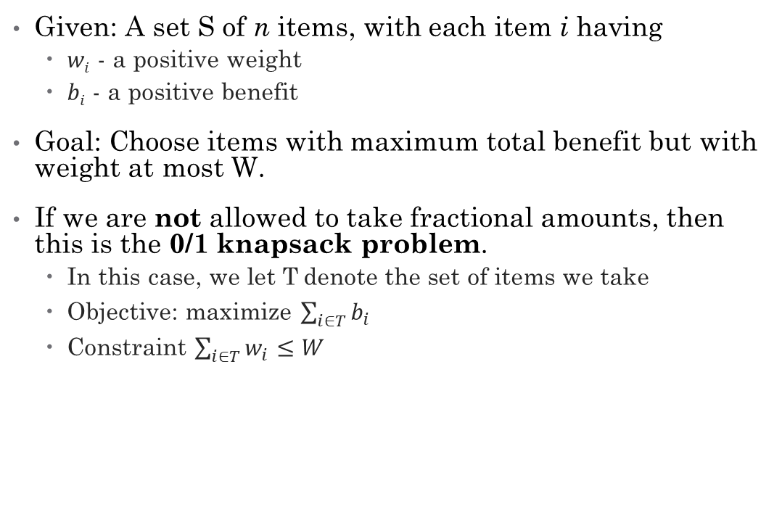
0-1 Knapsack Problem Formally
Given: A set S of n items, with each item i having
$wi$ - a positive weight
$bi$ - a positive benefit
Goal: Choose items with maximum total benefit but with weight at most W.
If we are not allowed to take fractional amounts, then this is the 0/1 knapsack problem.
In this case, we let T denote the set of items we take
Objective: maximize $\sum_{i∈T}{b_{i}}$
Constraint $\sum_{i∈T}{w_{i}≤W}$

Slide 52
Knapsack
Given: A set S of n items, with each item i having
b_{i} - a positive “benefit”
w_{i} - a positive “weight”
Goal: Choose items with maximum total benefit but with weight at most W.

Slide 53
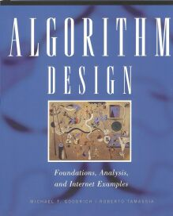
Knapsack
“knapsack”
Items:
box of width 9 in
1
2
3
4
5
Solution:
item 5 ($80, 2 in)
item 3 ($6, 2in)
item 1 ($20, 4in)
Weight:
4 in
2 in
2 in
6 in
2 in
Benefit:
$20
$3
$6
$25
$80
From Lectures of Prof. Roger Crawfis

Slide 54
Greedy Algorithm: Knapsack
No | Weight | Value | Ratio
1 | 1 | 6 | 6.0
2 | 2 | 11 | 5.5
3 | 4 | 1 | 0.25
4 | 4 | 12 | 3.0
5 | 6 | 19 | 3.167
6 | 7 | 12 | 1.714
Weight limit = W = 8
Greedy Solution: Take the highest ratio item that will fit: (1, 6), (2, 11), and (4, 12)
Total value = 6 + 11 + 12 = 29
Is this optimal?
No
Yes

Slide 55
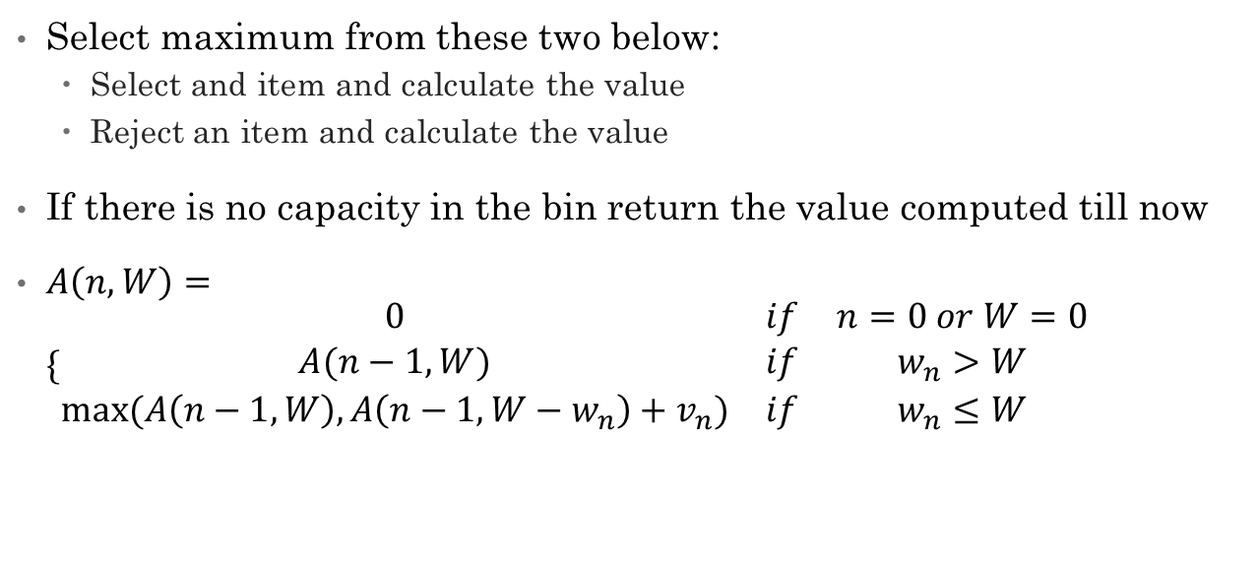
Knapsack DP Solution
Select maximum from these two below:
Select and item and calculate the value
Reject an item and calculate the value
If there is no capacity in the bin return the value computed till now
$A\left(n,W\right)=\{\begin{matrix}0 & if & n=0 or W=0 \\ A(n−1,W) & if & w_{n}>W \\ max⁡(A\left(n−1,W\right),A\left(n−1,W−w_{n}\right)+v_{n}) & if & w_{n}≤W\end{matrix}$

Slide 56
$$A\left(n,W\right)=\{\begin{matrix}A(n−1,W) & if & w_{n}>W \\ max⁡(A\left(n−1,W\right),A\left(n−1,W−w_{n}\right)+v_{n}) & if & w_{n}≤W\end{matrix}$$
item weight value
1 2 $12
2 1 $10
3 3 $20
4 2 $15
Knapsack of capacity W = 5
w₁ = 2, v₁= 12 w₂ = 1, v₂= 10
w₃ = 3, v₃= 20 w₄ = 2, v₄= 15
Max item allowed | Max Weight
 | 0 | 1 | 2 | 3 | 4 | 5
0
1
2
3
4

Slide 57
$$A\left(n,W\right)=\{\begin{matrix}A(n−1,W) & if & w_{n}>W \\ max⁡(A\left(n−1,W\right),A\left(n−1,W−w_{n}\right)+v_{n}) & if & w_{n}≤W\end{matrix}$$
item weight value
1 2 $12
2 1 $10
3 3 $20
4 2 $15
Knapsack of capacity W = 5
w₁ = 2, v₁= 12 w₂ = 1, v₂= 10
w₃ = 3, v₃= 20 w₄ = 2, v₄= 15
Max item allowed | Max Weight
 | 0 | 1 | 2 | 3 | 4 | 5
0 | 0 | 0 | 0 | 0 | 0 | 0
1 | 0
2 | 0
3 | 0
4 | 0

Slide 58
$$A\left(n,W\right)=\{\begin{matrix}A(n−1,W) & if & w_{n}>W \\ max⁡(A\left(n−1,W\right),A\left(n−1,W−w_{n}\right)+v_{n}) & if & w_{n}≤W\end{matrix}$$
item weight value
1 2 $12
2 1 $10
3 3 $20
4 2 $15
Knapsack of capacity W = 5
w₁ = 2, v₁= 12 w₂ = 1, v₂= 10
w₃ = 3, v₃= 20 w₄ = 2, v₄= 15
Max item allowed | Max Weight
 | 0 | 1 | 2 | 3 | 4 | 5
0 | 0 | 0 | 0 | 0 | 0 | 0
1 | 0 | 0
2 | 0
3 | 0
4 | 0

Slide 59
$$A\left(n,W\right)=\{\begin{matrix}A(n−1,W) & if & w_{n}>W \\ max⁡(A\left(n−1,W\right),A\left(n−1,W−w_{n}\right)+v_{n}) & if & w_{n}≤W\end{matrix}$$
item weight value
1 2 $12
2 1 $10
3 3 $20
4 2 $15
Knapsack of capacity W = 5
w₁ = 2, v₁= 12 w₂ = 1, v₂= 10
w₃ = 3, v₃= 20 w₄ = 2, v₄= 15
Max item allowed | Max Weight
 | 0 | 1 | 2 | 3 | 4 | 5
0 | 0 | 0 | 0 | 0 | 0 | 0
1 | 0 | 0 | 12
2 | 0
3 | 0
4 | 0

Slide 60
$$A\left(n,W\right)=\{\begin{matrix}A(n−1,W) & if & w_{n}>W \\ max⁡(A\left(n−1,W\right),A\left(n−1,W−w_{n}\right)+v_{n}) & if & w_{n}≤W\end{matrix}$$
item weight value
1 2 $12
2 1 $10
3 3 $20
4 2 $15
Max item allowed | Max Weight
 | 0 | 1 | 2 | 3 | 4 | 5
0 | 0 | 0 | 0 | 0 | 0 | 0
1 | 0 | 0 | 12 | 12 | 12 | 12
2 | 0
3 | 0
4 | 0

Slide 61
$$A\left(n,W\right)=\{\begin{matrix}A(n−1,W) & if & w_{n}>W \\ max⁡(A\left(n−1,W\right),A\left(n−1,W−w_{n}\right)+v_{n}) & if & w_{n}≤W\end{matrix}$$
item weight value
1 2 $12
2 1 $10
3 3 $20
4 2 $15
Max item allowed | Max Weight
 | 0 | 1 | 2 | 3 | 4 | 5
0 | 0 | 0 | 0 | 0 | 0 | 0
1 | 0 | 0 | 12 | 12 | 12 | 12
2 | 0 | 10 | 12 | 22 | 22 | 22
3 | 0
4 | 0

Slide 62
$$A\left(n,W\right)=\{\begin{matrix}A(n−1,W) & if & w_{n}>W \\ max⁡(A\left(n−1,W\right),A\left(n−1,W−w_{n}\right)+v_{n}) & if & w_{n}≤W\end{matrix}$$
item weight value
1 2 $12
2 1 $10
3 3 $20
4 2 $15
Max item allowed | Max Weight
 | 0 | 1 | 2 | 3 | 4 | 5
0 | 0 | 0 | 0 | 0 | 0 | 0
1 | 0 | 0 | 12 | 12 | 12 | 12
2 | 0 | 10 | 12 | 22 | 22 | 22
3 | 0 | 10 | 12 | 22 | 30 | 32
4 | 0

Slide 63
$$A\left(n,W\right)=\{\begin{matrix}A(n−1,W) & if & w_{n}>W \\ max⁡(A\left(n−1,W\right),A\left(n−1,W−w_{n}\right)+v_{n}) & if & w_{n}≤W\end{matrix}$$
item weight value
1 2 $12
2 1 $10
3 3 $20
4 2 $15
Max item allowed | Max Weight
 | 0 | 1 | 2 | 3 | 4 | 5
0 | 0 | 0 | 0 | 0 | 0 | 0
1 | 0 | 0 | 12 | 12 | 12 | 12
2 | 0 | 10 | 12 | 22 | 22 | 22
3 | 0 | 10 | 12 | 22 | 30 | 32
4 | 0 | 10 | 15 | 25 | 30

Slide 64

$$A\left(n,W\right)=\{\begin{matrix}A(n−1,W) & if & w_{n}>W \\ max⁡(A\left(n−1,W\right),A\left(n−1,W−w_{n}\right)+v_{n}) & if & w_{n}≤W\end{matrix}$$
item weight value
1 2 $12
2 1 $10
3 3 $20
4 2 $15
Max item allowed | Max Weight
 | 0 | 1 | 2 | 3 | 4 | 5
0 | 0 | 0 | 0 | 0 | 0 | 0
1 | 0 | 0 | 12 | 12 | 12 | 12
2 | 0 | 10 | 12 | 22 | 22 | 22
3 | 0 | 10 | 12 | 22 | 30 | 32
4 | 0 | 10 | 15 | 25 | 30 | 37

Slide 65
Algorithm
Algorithm 01Knapsack(S, W):
Input: set S of n items with benefit b_{i} and weight w_{i}; maximum weight W
Output: benefit of best subset of S with weight at most W
let A and B be arrays of length W + 1
for w ← 0 to W do
B[w] ← 0
for k ← 1 to n do
copy array B into array A
for w ← w_{k} to W do
if A[w−w_{k}] + b_{k} > A[w] then
B[w] ← A[w−w_{k}] + b_{k}
return B[W]
Since B[k,w] is defined in terms of B[k−1,*], we can use two arrays of instead of a matrix.
Running time is O(nW).
Not a polynomial-time algorithm since W may be large.
Called a pseudo-polynomial time algorithm.

Slide 66
CS2009 Design and Analysis of Algorithms
Longest Common Subsequence

Slide 67
LCS
A subsequence of a sequence/string S is obtained by deleting zero or more symbols from S. For example, the following are some subsequences of “president”: pred, sdn, predent. In other words, the letters of a subsequence of S appear in order in S, but they are not required to be consecutive.
The longest common subsequence problem is to find a maximum length common subsequence between two sequences.

Slide 68
Example
Sequence 1: president
Sequence 2: providence
Its LCS is priden.
president
providence

Slide 69
Example
Sequence 1: algorithm
Sequence 2: alignment
One of its LCS is algm
a l g o r i t h m
a l i g n m e n t

Slide 70
Algorithm 1
For every subsequence of X, check whether it’s a subsequence of Y .
Time: Θ(n2^{m}).
2^{m} subsequences of X to check.
Each subsequence takes Θ(n) time to check:
scan Y for first letter, for second, and so on.

Slide 71
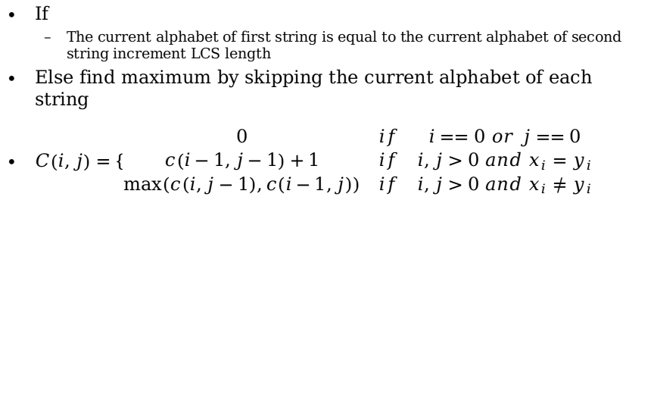
DP Algorithm
If
The current alphabet of first string is equal to the current alphabet of second string increment LCS length
Else find maximum by skipping the current alphabet of each string
$C\left(i,j\right)=\{\begin{matrix}0 & if & i==0 or j==0 \\ c\left(i−1,j−1\right)+1 & if & i,j>0 and x_{i}=y_{i} \\ max⁡(c\left(i,j−1\right),c(i−1,j)) & if & i,j>0 and x_{i}≠y_{i}\end{matrix}$

Slide 72
Recursive Solution
c[springtime, printing]
c[springtim, printing] c[springtime, printin]
[springti, printing] [springtim, printin] [springtim, printin] [springtime, printi]
[springt, printing] [springti, printin] [springtim, printi] [springtime, print]

Slide 73
Recursive Solution
 |  | p | r | i | n | t | i | n | g
s
p
r
i
n
g
t
i
m
e
Keep track of c[α,β] in a table of nm entries:
top/down
bottom/up

Slide 74
LCS Algorithm

Slide 75
Running time and memory: O(mn) and O(mn).

Slide 76
The Backtracking Algorithm
procedure Output-LCS(A, prev, i, j)
if i = 0 or j = 0 then return
if prev(i, j)=”“ then Output-LCS(A, prev, i-1, j-1) Print A[i];
else if prev(i, j)=”↑“ then Output-LCS(A, prev, i-1, j)
else Output-LCS(A, prev, i, j-1)

Slide 77
Example

Slide 78
CS2009 Design and Analysis of Algorithm
Rod Cutting

Slide 79
Rod cutting
Decide where to cut steel rods:
Given a rod of length n inches and a table of prices p_{i}, i=1,2,…,n, find the maximum revenue r_{n} obtainable by cutting up the rod and selling the pieces
Rod lengths are integers
For i=1,2,…,n we know the price p_{i} of a rod of length i inches

Slide 80
Example
length I: 1 2 3 4 5 6 7 8 9 10
------------------------------------------------
price p_{i}: 1 5 8 9 10 17 17 20 24 30
For a rod of length 4: 2+2 is optimal (p₂+p₂=10)
In general, can cut a rod of length n 2^{n-1} ways

Slide 81
Solution
If optimal sol. cuts rod in k pieces then
optimal decomposition: n=i₁+i₂+…+i_{k}
Revenue: r_{n}=p_{i1}+p_{i2}+…+p_{ik}
In general: r_{n}=max{p_{n},r₁+r_{n-1},r₂+r_{n-2},…,r_{n-1}+r₁}
Initial cut of the rod: two pieces of size i and n-I
Revenue r_{i} and r_{n-i} from those two pieces
Need to consider all possible values of i
May get better revenue if we sell the rod uncut

Slide 82
A different view of the problem
Decomposition in
A first, left-hand piece of length i
A right-hand reminder of length n-i
Only the reminder is further divided
Then
r_{n}=max{p_{i}+r_{n-i}, 1 <= i <= n}
Thus, need solution to only one subproblem

Slide 83
Top-down implementation
CUT-ROD(p,n)
if n==0
return 0
q = -∞
for i=1 to n
q=max{q,p[i]+CUT-ROAD(p,n-i)}
return q
Time recurrence: T(n)=1+T(1)+T(2)+…+T(n-1)
T(n)=O(2^{n})

Slide 84
Dynamic Programming
Optimality of subproblems is obvious
DP-CUT-ROD(p,n)
let r[0..n], s[0..n] be new arrays
r[0]=0
for j=1 to n
q=-∞
for i=1 to j
if q < p[i]+r[j-i]
s[j]=i; q= p[i]+r[j-i]
r[j]=q
return r and s

Slide 85
Retrieving an optimal solution
PRINT-CUT-ROD
(r,s) = DP-CUT-ROD(p,n)
while n>0
print s[n]
n=n-s[n]
Example:
i 0 1 2 3 4 5 6 7
r[i] 0 1 5 8 10 13 17 18
s[i] 0 1 2 3 2 2 6 1

